Slide 1
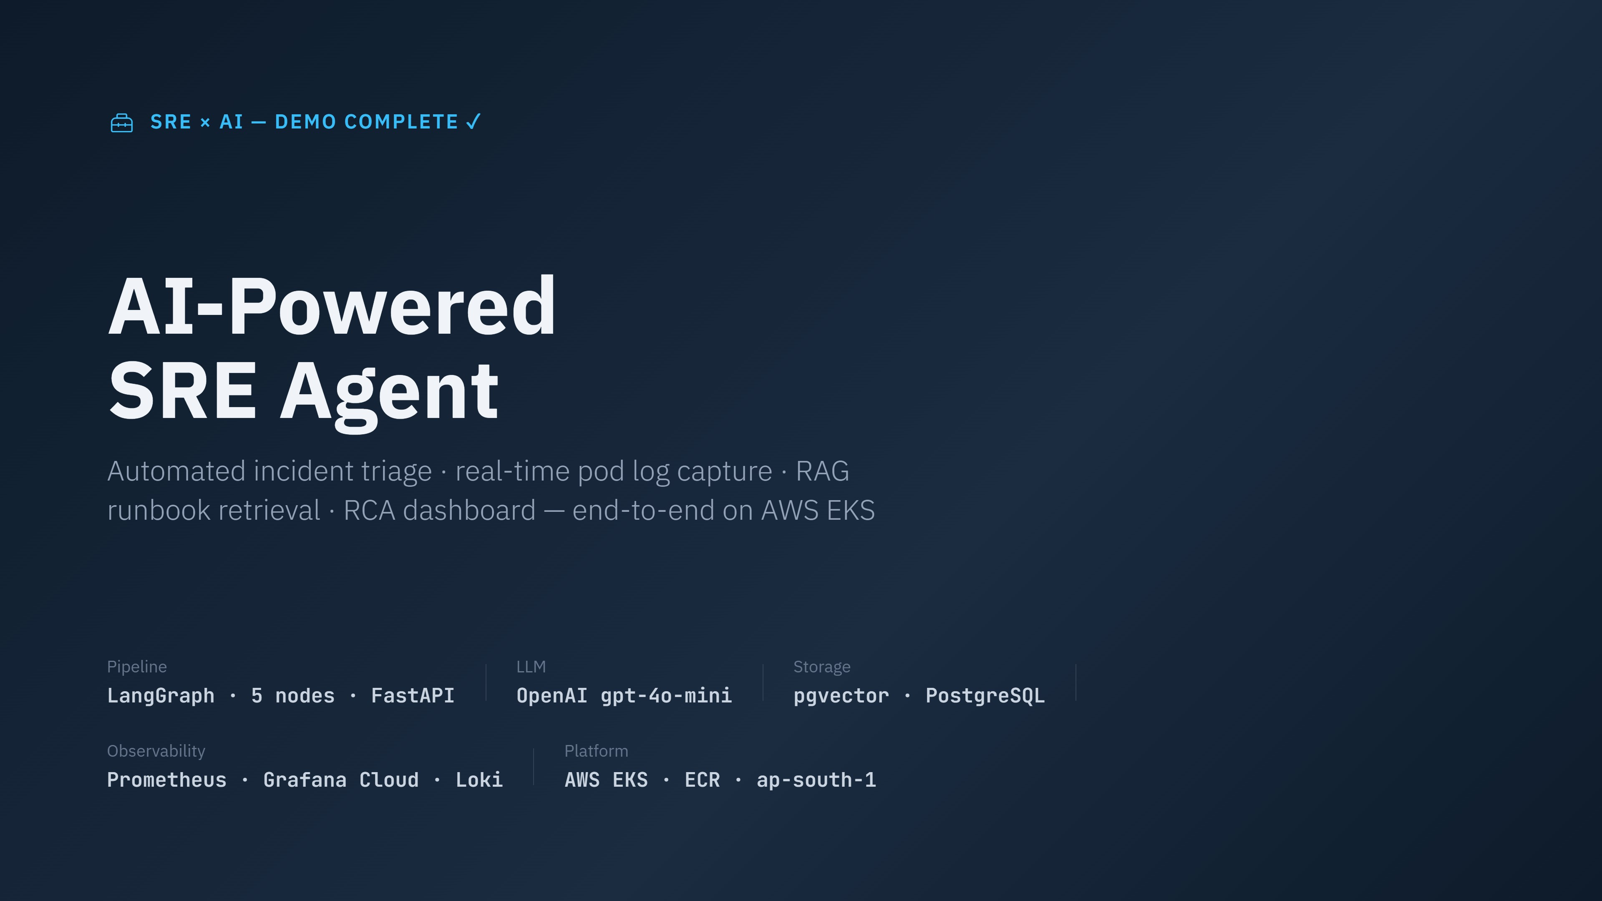
Notes:
Welcome. I built an AI agent from scratch that acts as an automated SRE — it receives Grafana alerts, captures real pod logs at incident time, runs a 5-node LangGraph pipeline for root cause analysis, and surfaces everything in an incident dashboard. Full end-to-end workflow verified and complete.

Slide 2
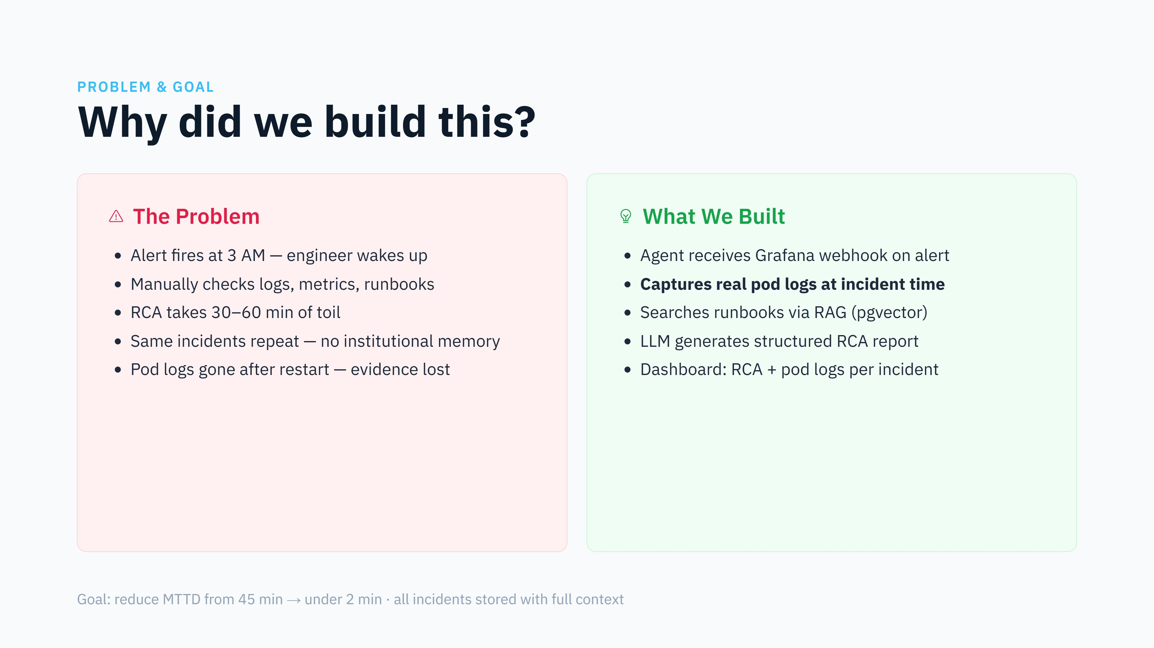
Notes:
The core problem every SRE faces: repetitive manual incident response with no institutional memory. Our agent automates the entire first-response cycle including capturing the pod logs before they disappear after a restart.

Slide 3
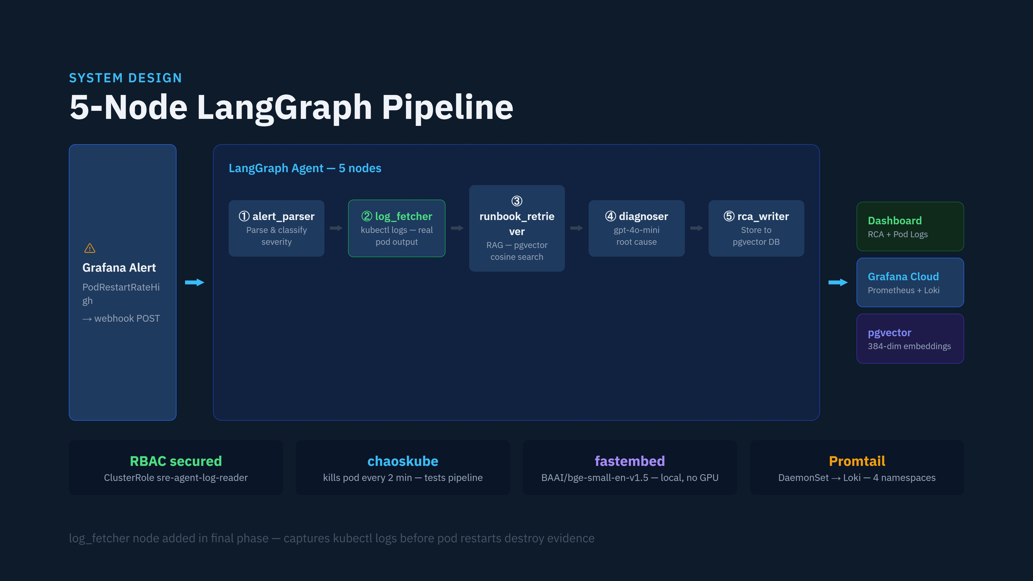
Notes:
The key addition in the final phase was the log_fetcher node — it runs kubectl logs against the alerting pod before it restarts and stores the raw output alongside the RCA. This is what shows up in the dashboard's POD LOGS AT INCIDENT TIME section.

Slide 4
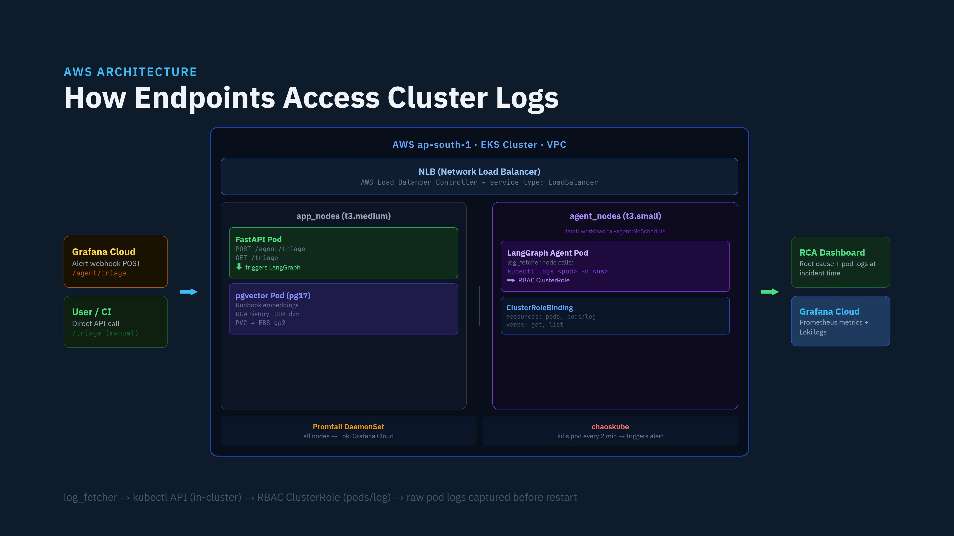
Notes:
The key flow: Grafana alert fires a webhook to /agent/triage on the NLB → FastAPI pod on app_nodes triggers LangGraph → LangGraph agent pod on agent_nodes (tainted, tolerated) runs log_fetcher which calls the Kubernetes API in-cluster using a ServiceAccount bound to a ClusterRole that grants pods/log access → captures raw logs before chaoskube kills the pod again. pgvector holds runbook embeddings (EBS PVC) and stores completed RCAs.

Slide 5
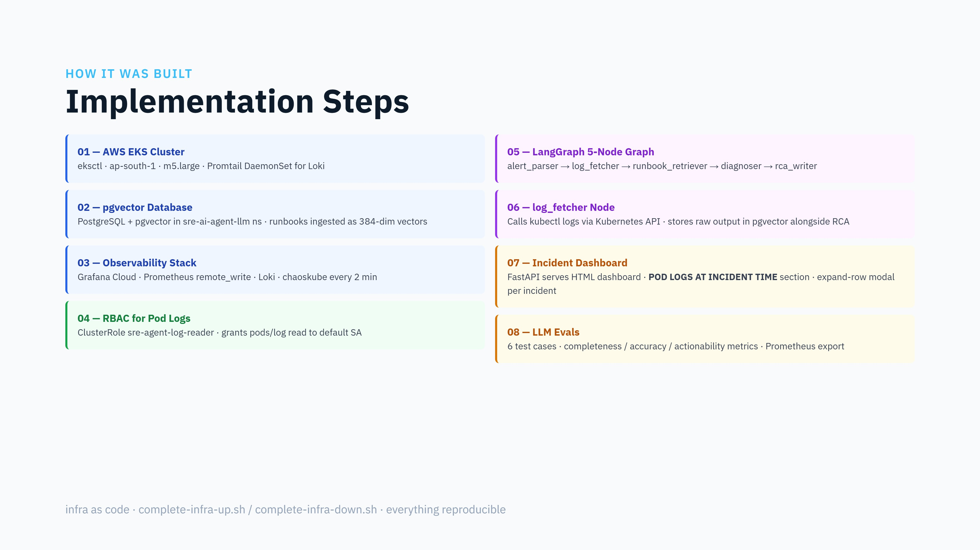
Notes:
Each step built on the previous. RBAC was the key unlock for log capture — without it the Kubernetes API would reject pod log reads from inside the cluster. The 5-node graph is a straight compile-time StateGraph that executes synchronously on each incoming alert.

Slide 6
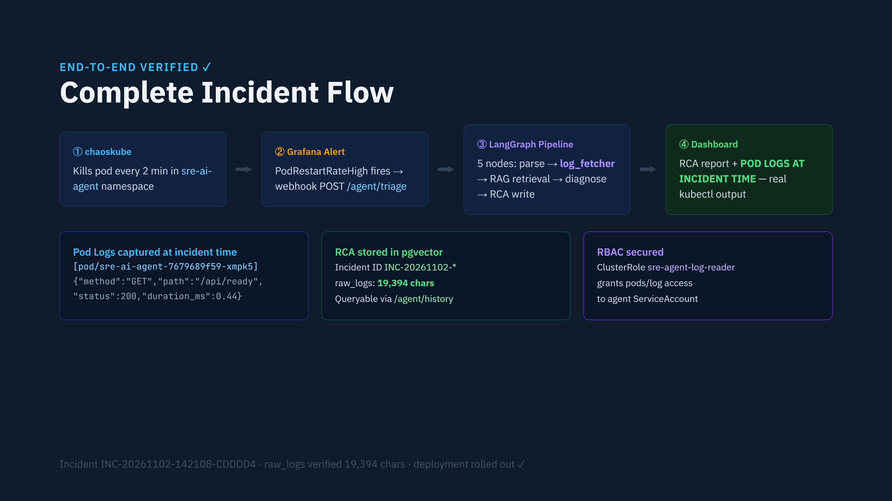
Notes:
This is the complete flow verified live. chaoskube kills a pod, Grafana fires an alert, LangGraph's log_fetcher node captures real kubectl logs at incident time, the diagnoser runs RAG against runbooks, and the dashboard shows both the RCA report and the actual pod logs. All stored in pgvector with a full audit trail.

Slide 7
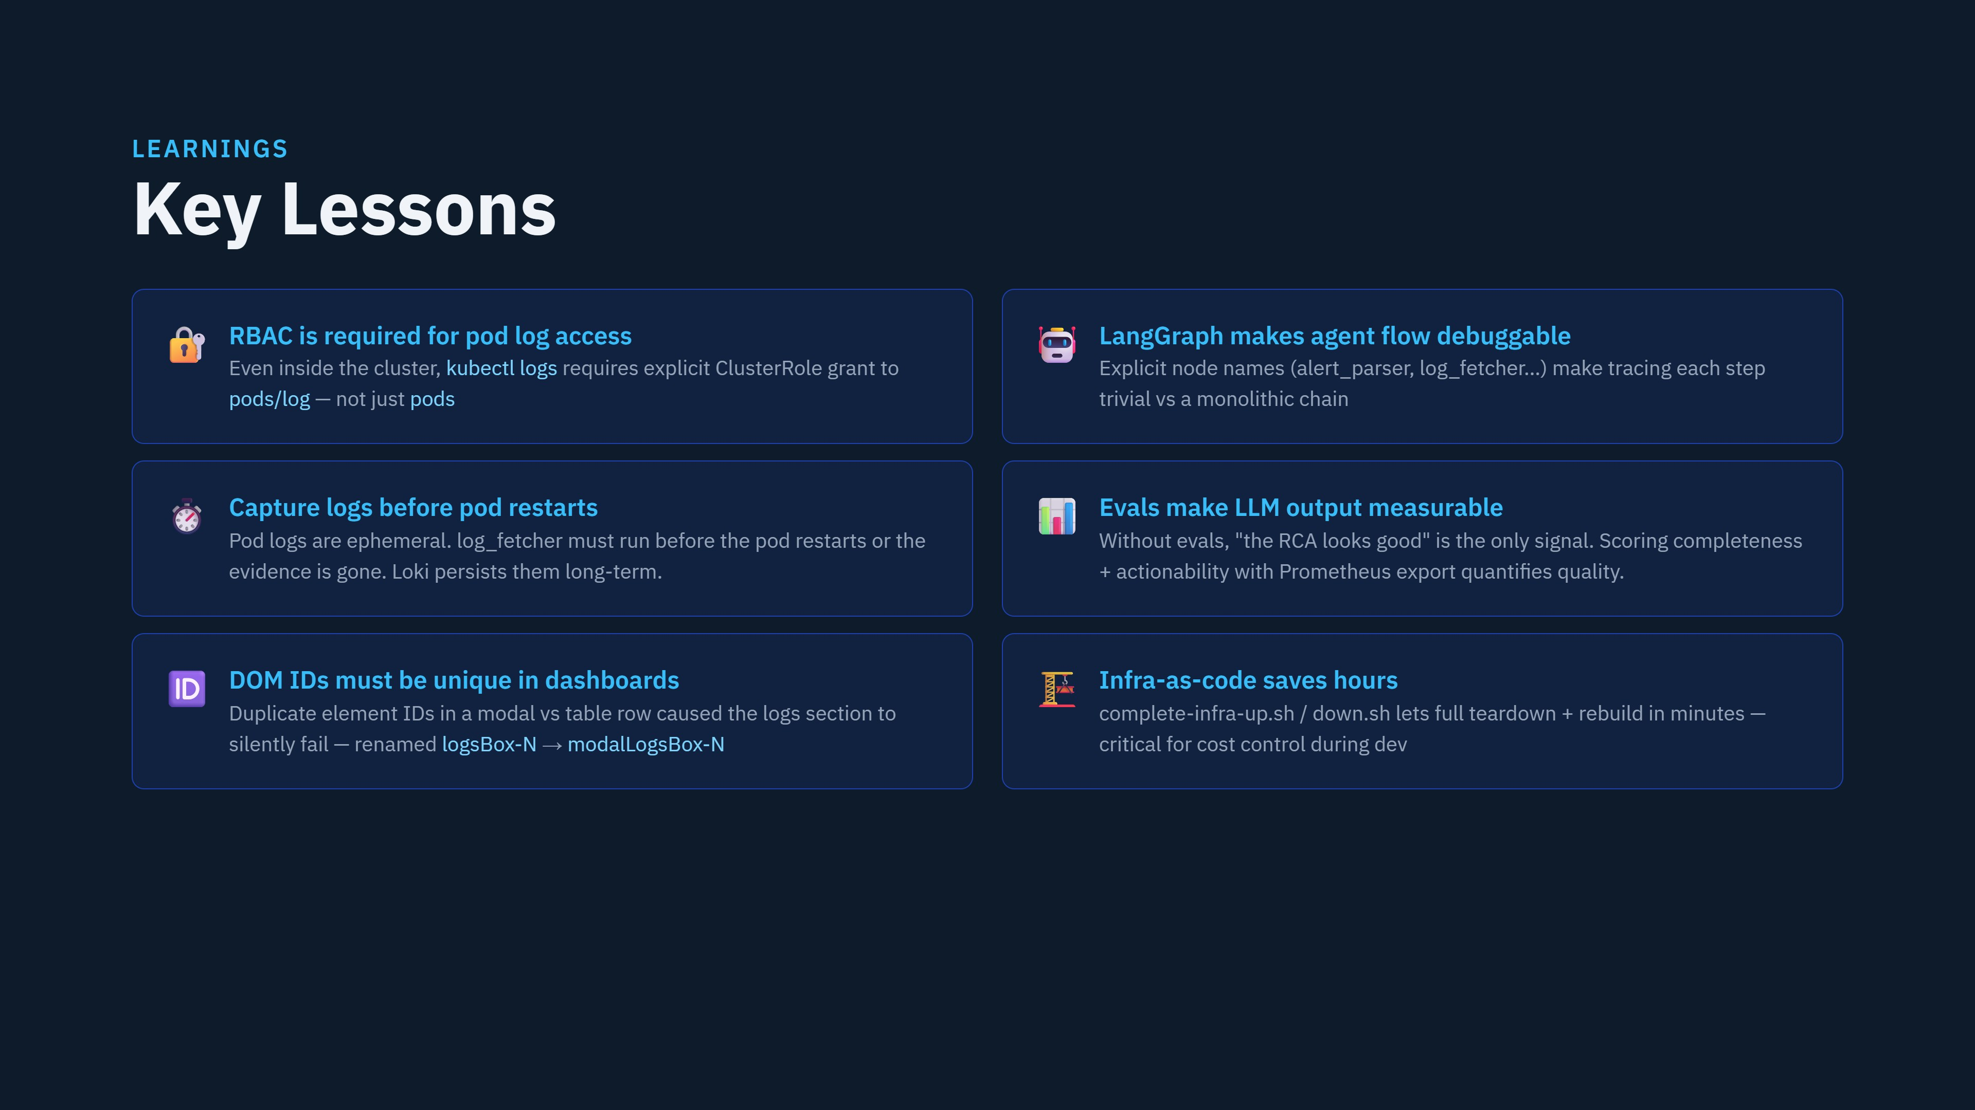
Notes:
The RBAC and DOM ID lessons came from real bugs hit during the build. RBAC: pod logs silently returned empty. Dashboard: the logs section showed nothing even though the data was there. Both fixed and committed to the repo.

Slide 8
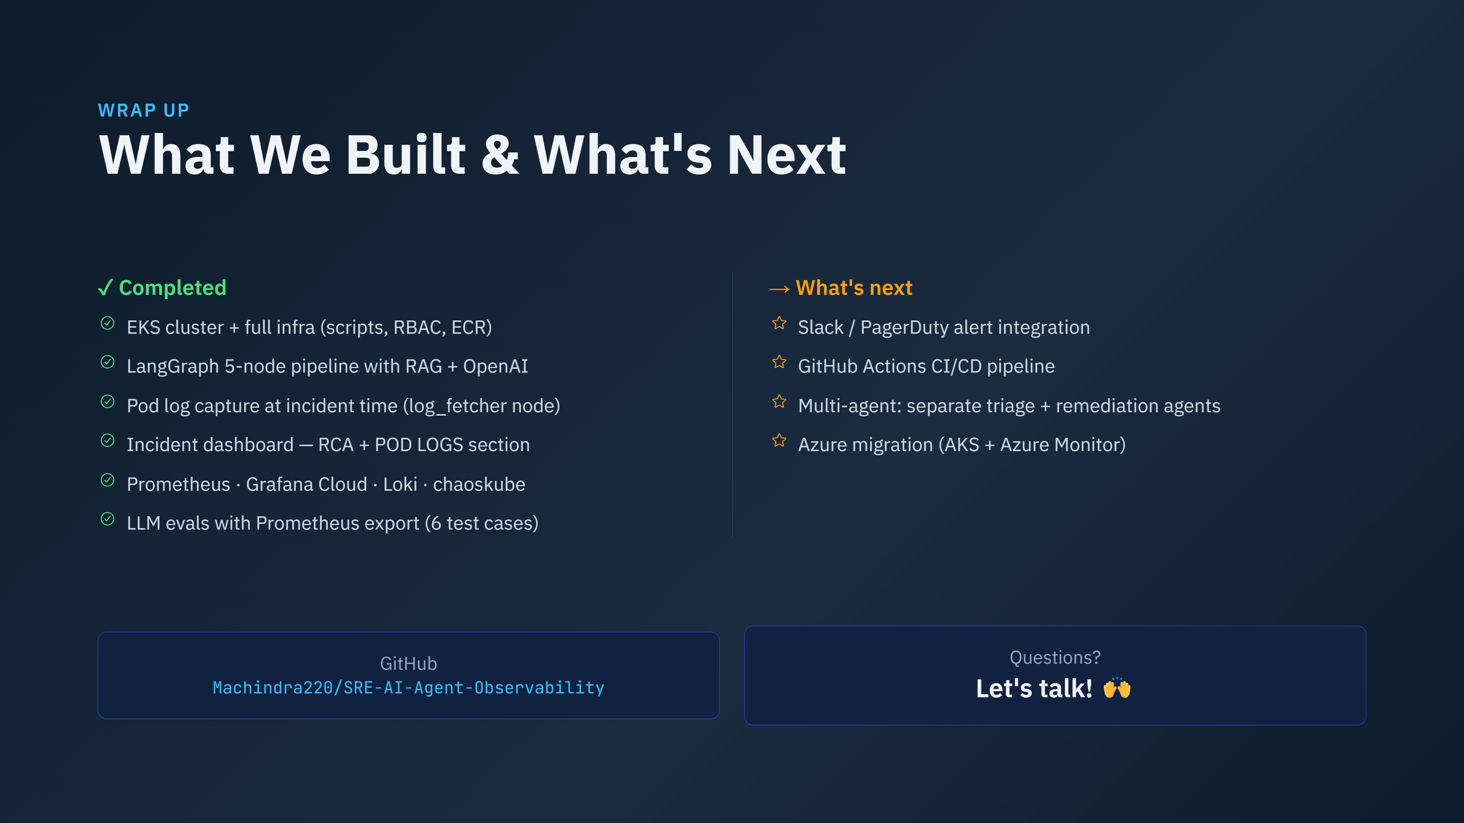
Notes:
That's a wrap. The complete workflow is verified — chaos injection, alert, LangGraph pipeline, pod log capture, RCA stored in pgvector, dashboard showing everything. Infra is now torn down. Happy to do a live walkthrough of the repo or any part of the pipeline.

